Slide 1
APTITUDE
DATA INTERPRETATION
(MIX TYPE) 1

Slide 2
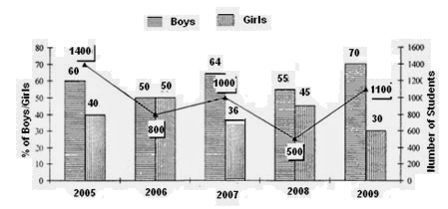
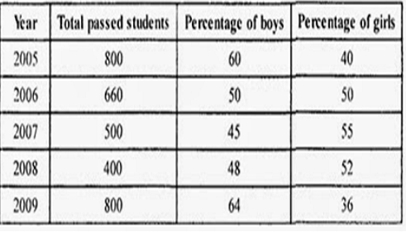
APTITUDE
PUZZLE TEST VIDEO-Directions (1-5): The following bar graph shows the percentage of boys and girls appeared for Class X exam for the period of five years 2005-2009. The line shows he total number of students appeared and the table shows the total students passed and percentage of boys and girls passed in the exam.

Slide 3
APTITUDE
DATA INTERPRETATION VIDEO-1
Q:1. What is the number of girls who failed in the year 2007?
75 (2) 80 (3) 85 (4) 90 (5) None of these
Q:2. What is the sum of girls passed and boys failed in the year 2009?
546 (2) 556 (3) 566 (4) 576 (5) None of these
Q:3. What is the difference between the total boys appeared and the total boys passed in the period of five years?
1146 (2) 1156 (3) 1166 (4) 1176 (5) None of these
Q:4.What is the ratio of the total boys appeared in the year 2009 to the total girls passed in the year 2006?
7 : 5 (2) 7 : 4 (3) 7 : 3 (4) 7 : 2 (5) None of these
Q:5. The number of boys passed in the year 2005 is what per cent more than the number of girls appeared in the year 2006?
(1) 10% (2) 20% (3) 25% (4) 40% (5) None of these

Slide 4
APTITUDE
DATA INTERPRETATION VIDEO-1
Q:1. What is the number of girls who failed in the year 2007?
75 (2) 80 (3) 85 (4) 90 (5) None of these
Q:2. What is the sum of girls passed and boys failed in the year 2009?
(1) 546 (2) 556 (3) 566 (4) 576 (5) None of these
Q:3. What is the difference between the total boys appeared and the total boys passed in the period of five years?
1146 (2) 1156 (3) 1166 (4) 1176 (5) None of these
Q:4.What is the ratio of the total boys appeared in the year 2009 to the total girls passed in the year 2006?
7 : 5 (2) 7 : 4 (3) 7 : 3 (4) 7 : 2 (5) None of these
Q:5. The number of boys passed in the year 2005 is what per cent more than the number of girls appeared in the year 2006?
(1) 10% (2) 20% (3) 25% (4) 40% (5) None of these

Slide 5
APTITUDE
DATA INTERPRETATION
(MIX TYPE) 2

Slide 6
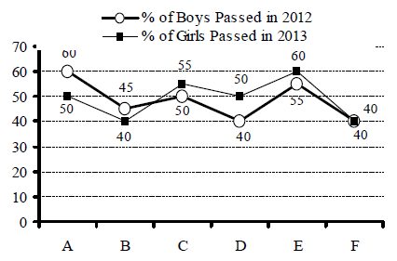
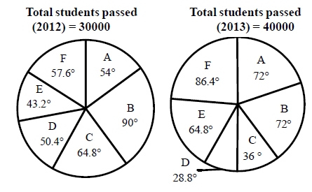
APTITUDE
DATA INTERPRETATION VIDEO-2
Directions(1--5): In the given pie -charts the distribution of passed students from six different colleges (A, B, C, D, E and F) of a city during the year 2012 and 2013 is given. In the line graph the percentage of boys passed in year 2012 and the percentage of girls passed in 2013 is shown. Answer the following questions based on these graphs. Total students passed in 2012 = 30000 Total students passed in 2013 = 40000

Slide 7
APTITUDE
DATA INTERPRETATION VIDEO-2
Q:1. What is the number of female students passing in 2012 from College C?
2000 2) 2300 3) 2400 4) 2500 5) 2700
Q:2. What is the number of male students passing in year-2013 from College F?
5760 2) 5750 3) 5740 4) 5730 5) 5720
Q:3.What is the total number of females passing in 2012 from all colleges?
14645 2) 15645 3) 16645 4) 17645 5) 18645
Q:4.What is the difference between the number of male students passing in year 2013 and that of female students passing in the same year from college B?
1600 2) 1680 3) 1670 4) 1660 5) 1650
Q:5.Number of boys passing from College E in 2012 is what percentage of the number of boys passing from College C in year 2013?
1) 70% 2) 80% 3) 90% 4) 100% 5) None of these

Slide 8
APTITUDE
DATA INTERPRETATION VIDEO-2
Q:1. What is the number of female students passing in 2012 from College C?
2000 2) 2300 3) 2400 4) 2500 5) 2700
Q:2. What is the number of male students passing in year-2013 from College F?
1) 5760 2) 5750 3) 5740 4) 5730 5) 5720
Q:3.What is the total number of females passing in 2012 from all colleges?
14645 2) 15645 3) 16645 4) 17645 5) 18645
Q:4.What is the difference between the number of male students passing in year 2013 and that of female students passing in the same year from college B?
1) 1600 2) 1680 3) 1670 4) 1660 5) 1650
Q:5.Number of boys passing from College E in 2012 is what percentage of the number of boys passing from College C in year 2013?
1) 70% 2) 80% 3) 90% 4) 100% 5) None of these

Slide 9
APTITUDE
DATA INTERPRETATION
(MIX TYPE) 3

Slide 10
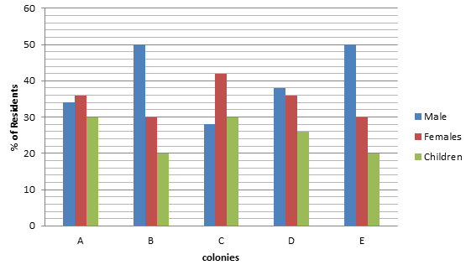

APTITUDE
DATA INTERPRETATION VIDEO-3
Directions : (1--5) Study the following graph and table carefully and answer the given questions Percentage of Males, Females and Children Living in Various Colonies
A | 1250
B | 2050
C | 1800
D | 1150
E | 1620

Slide 11
APTITUDE
DATA INTERPRETATION VIDEO-3
Q:1. What is the total number of females in Colonies A, B and C together?
1785 (2) 1821 (3) 1479 (4) 1692 (5) None of these
Q:2.The number of children in Colony A are approximately what per cent of the number of children in Colony E?
121 (2) 116 (3) 75 (4) 101 (5) 98
Q:3.What is the respective ratio of the number of males in Colony B to the number of females in the same colony?
3 : 5 (2) 7 : 5 (3) 8 : 7 (4) 5 : 7 (5) None of these
Q:4.What is the average number of residents from all the colonies together?
1654 (2) 1600 (3) 1580 (4) 1574 (5) None of these
Q:5.What is the difference between the number of males in Colony D and the number of children in the same colony?
(1) 138 (2) 126 (3) 136 (4) 135 (5) None of these

Slide 12
APTITUDE
DATA INTERPRETATION VIDEO-3
Q:1. What is the total number of females in Colonies A, B and C together?
1785 (2) 1821 (3) 1479 (4) 1692 (5) None of these
Q:2.The number of children in Colony A are approximately what per cent of the number of children in Colony E?
121 (2) 116 (3) 75 (4) 101 (5) 98
Q:3.What is the respective ratio of the number of males in Colony B to the number of females in the same colony?
3 : 5 (2) 7 : 5 (3) 8 : 7 (4) 5 : 7 (5) None of these
Q:4.What is the average number of residents from all the colonies together?
1654 (2) 1600 (3) 1580 (4) 1574 (5) None of these
Q:5.What is the difference between the number of males in Colony D and the number of children in the same colony?
(1) 138 (2) 126 (3) 136 (4) 135 (5) None of these

Slide 13
APTITUDE
DATA INTERPRETATION
(MIX TYPE) 4

Slide 14
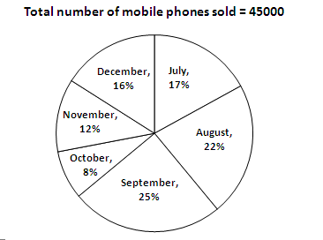
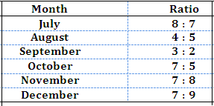
APTITUDE
DATA INTERPRETATION VIDEO-4
Directions (1—4): Study the following pie-chart and table carefully and answer the questions given below:
PIE CHAET:- Percentage-wise distribution of the number of mobile phones sold by a shopkeeper during six months
TABLE:- The ratio between the numbers of mobile phones sold of Company A and Company B during six months

Slide 15
APTITUDE
DATA INTERPRETATION VIDEO-4
Q:1. What is the ratio of the number of mobile phones sold of Company B during July to those sold during December of the same company?
119: 145 2) 116: 135 3) 119: 135 4) 119: 130 5) None of these
Q:2.If the shopkeeper earned a profit of Rs. 433 on each mobile phone sold of Company B during October, what was his total profit earned on the mobile phones of that company during the same month?
Rs. 6,49,900 2)Rs. 6,45,900 3) Rs. 6,49,400 4) Rs. 6,49,500 5) None of these
Q:3.The number of mobile phones sold of Company A during July is approximately what percent of the number of mobile phones sold of Company A during December?
110 2) 140 3) 150 4) 105 5) 130
Q:4. What is the total number of mobile phones sold of Company B during August and September together?
10000 2) 15000 3) 10500 4) 9500 5) None of these

Slide 16
APTITUDE
DATA INTERPRETATION VIDEO-4
Q:1. What is the ratio of the number of mobile phones sold of Company B during July to those sold during December of the same company?
119: 145 2) 116: 135 3) 119: 135 4) 119: 130 5) None of these
Q:2.If the shopkeeper earned a profit of Rs. 433 on each mobile phone sold of Company B during October, what was his total profit earned on the mobile phones of that company during the same month?
Rs. 6,49,900 2)Rs. 6,45,900 3) Rs. 6,49,400 4) Rs. 6,49,500 5) None of these
Q:3.The number of mobile phones sold of Company A during July is approximately what percent of the number of mobile phones sold of Company A during December?
110 2) 140 3) 150 4) 105 5) 130
Q:4. What is the total number of mobile phones sold of Company B during August and September together?
1) 10000 2) 15000 3) 10500 4) 9500 5) None of these

Slide 17
APTITUDE
THANK YOU

